Slide 1

ANNAMACHARYA INSTITUTE OF TECHNOLOGY & SCIENCES::TIRUPATI (AUTONOMOUS) Computer Science and Engineering A.Y.: 2022-2023 IMPLEMENTATION, TESTING AND RESULTS REVIEW AGE AND GENDER DETECTION USING DEEP LEARNING
BATCH NO: 31
19AK1A0579 LAKSHMI PRIYA .G
19AK1A0574 KALAVATHI .Y
20AK5A0506 PAVAN KALYAN .Y 19AK1A05C5 RAJASHEKAR .P
Under the Guidance of
Mr. N. VENKATRAMANA, M. Tech
Assistant Professor
Department of CSE
AITS, Tirupati

Slide 2
ABSTRACT
A Human face shows various emotions, expressions, and many more. Here we are going to determine the age of a human person through his/her face. Automatic prediction of age and gender from face images has drawn a lot of attention recently, due it is wide applications in various facial analysis problems.
The age estimation from the face is a challenging problem because of many internal factors, such as gender and age, and external factors, such as environments and lifestyles.
Using attention mechanism enables our model to focus on the important and informative parts of the face, which can help it to make a more accurate prediction. We train our model in a multi-task learning fashion, and augment the feature embedding of the age classifier, with the predicted gender.
In this project, we are going to use Deep Learning to accurately identify the gender and age of a person from the image of a face. The predicted gender may be one of ‘Male’ and ‘female’ and the predicted age is in the range of (0 – 2), (3 – 6), (7 – 12), (13 – 20), (21 – 32), (33 – 43), (44 – 53), (54 – 60) and so on.

Slide 3
INTRODUCTION
Age and gender information are especially important for various real-world applications, such as social understanding, biometrics, identity verification, video surveillance, human computer interaction, electronic customer, crowd behaviour analysis, online advertisement, item recommendation, and many more.
Despite their huge applications, being able to automatically predicting age and gender from face images is an extremely hard problem, due to the various sources of intra-class variations on the facial images of people.
In this work, we propose a deep learning framework to jointly predict the age and gender from face images. We use an attentional convolutional network as one of our backbone models, to better attend to the salient and informative part of the face.
Also, given that knowing the gender of someone, we can better estimate her/his age, we augment the feature of the age-prediction branch with the predicted gender output.

Slide 4
EXISTING SYSTEM
The homo sapiens are more enthusiastic to know the age of a person by using this project we can find out the age within the range.
Even humans cannot accurately predict the age based on looking at a person however we have an idea of whether they are in their 20's or in their 30's, because of this reason it is wise to frame this problem as a classification problem where we try to estimate the age group the person is in.

Slide 5
PROPOSED SYSTEM
The main objective of gender and age detection is to guess the gender and age of the face of an individual in a picture using Deep Learning on the audience dataset.
Moreover, to get the most effective predictions and result by overcoming the problem of accuracy and time.

Slide 6
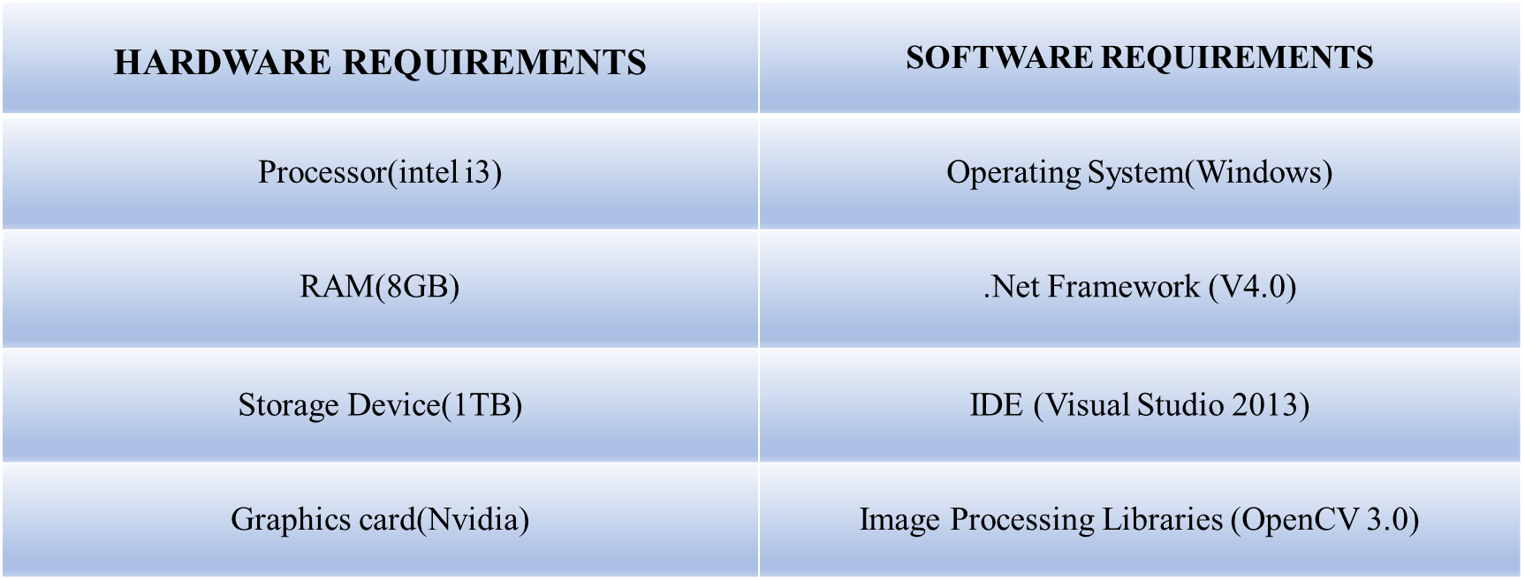
MINIMUM SYSTEM REQUIREMENTS

Slide 7
SYSTEM ANALYSIS
Initially an image is given as input to the system or we must take the input by using system camera. The image is processed by using Convolutional Neural Networks (CNN) in deep learning,
The aim of the convolutional neural network is to split the image features like eyes, nose, chin, cheeks, lips etc. After that, the features are compared with the trained data set i.e., ADIENT DATASET.
Each picture which in trained in dataset are compared with the given input image.

Slide 8
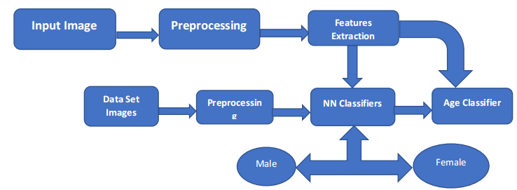
CONTENT DIAGRAM

Slide 9
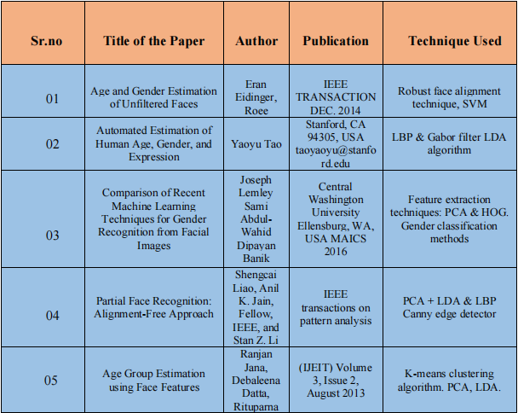
LITERATURE REVIEW

Slide 10
MODULES
The project will work in the following modules:
Detect the faces.
classify Gender into male / female.
Classify into one of the ranges of the Age as in Audience Dataset.
Put the results on the image and display it.

Slide 11
SYSTEM DESIGN
The network architecture used for age approximation in based on the paper of G. Levi and T. Hassner. This network is intended to be shallow to prevent over-fitting. All the three colors i.e., Red, Green, Blue are processed directly.
The images are scaled to 256 x 256 and cropped to 227 x 227. The network consists of 3convolution layers followed by 3 fully connected layers.

Slide 12
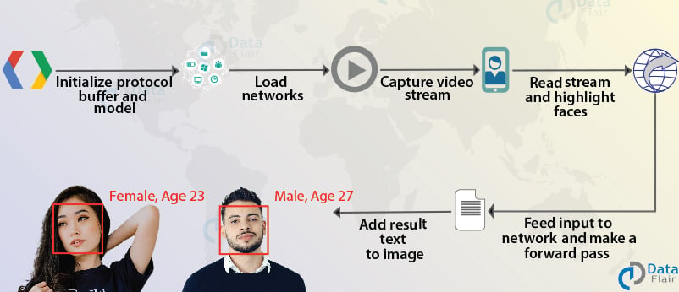
SYSTEM DESIGN
Architecture

Slide 13
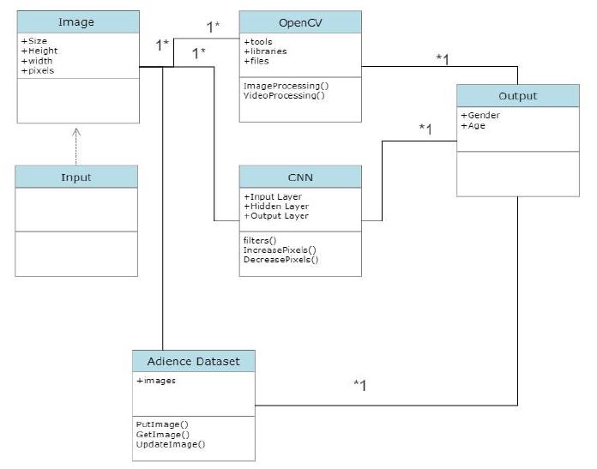
UML DIAGRAMS
Class Diagram

Slide 14
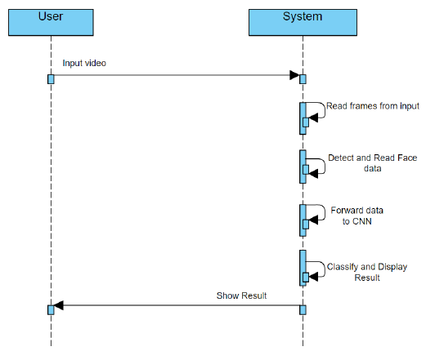
UML DIAGRAMS
Sequence Diagram

Slide 15
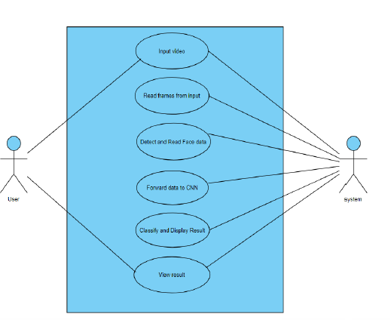
UML DIAGRAMS
Use Case Diagram

Slide 16
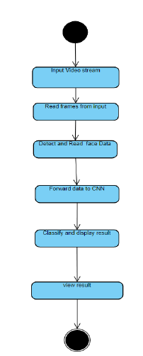
UML DIAGRAMS
State Chart Diagram

Slide 17
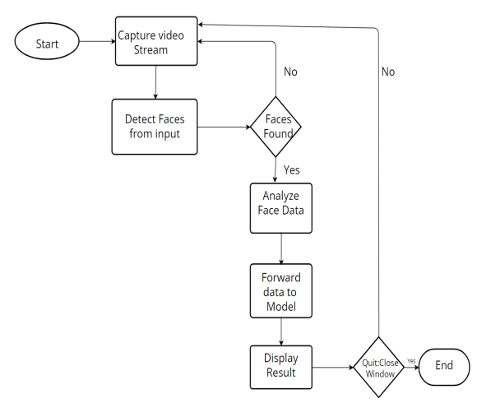
DATA FLOW DIAGRAM

Slide 18
AUDIENCE DATA SET DESIGN
Gender | 0 - 3 | 4 - 8 | 9 - 13 | 14 - 20 | 21 - 25 | 26 - 32 | 33 - 40 | 41 - 48 | 48 - 55
Male | 700 | 900 | 900 | 700 | 2300 | 1200 | 1300 | 800 | 700
Female | 700 | 900 | 1200 | 1450 | 2700 | 1500 | 1700 | 800 | 650
Both | 1400 | 1800 | 2100 | 2150 | 5000 | 2700 | 3000 | 1600 | 1350
55 - 62 | 62 - 100 | Total
750 | 450 | 10,700
500 | 400 | 12,500
1250 | 850 | 23,200

Slide 19
IMPLEMENTATION
IMPLEMENTATION OF KEY FUNCTIONS:
The Key functions that are to be noticed, processed, and implemented are:
Detect Faces
Classify into Male/Female
Classify into one of the 8 age ranges (0 – 3), (4 – 6), (7 – 12), (13 – 20), (21 – 32), (33 – 43), (44 – 53), (54 – 100).
Put the results on the image and display it

Slide 20
IMPLEMENTATION
METHOD OF IMPLEMENTATION:
import cv2
import math
import argparse
def highlightFace(net, frame, conf_threshold=0.7):
frameOpencvDnn=frame.copy()
frameHeight=frameOpencvDnn.shape[0]
frameWidth=frameOpencvDnn.shape[1]
blob=cv2.dnn.blobFromImage(frameOpencvDnn, 1.0, (300, 300), [104, 117, 123], True, False)

Slide 21
IMPLEMENTATION
METHOD OF IMPLEMENTATION:
net.setInput(blob)
detections=net.forward()
faceBoxes=[]
for i in range(detections.shape[2]):
confidence=detections[0,0,i,2]
if confidence>conf_threshold:
x1=int(detections[0,0,i,3]*frameWidth)
y1=int(detections[0,0,i,4]*frameHeight)
x2=int(detections[0,0,i,5]*frameWidth)
y2=int(detections[0,0,i,6]*frameHeight)
faceBoxes.append([x1,y1,x2,y2])
cv2.rectangle(frameOpencvDnn, (x1,y1), (x2,y2), (0,255,0), int(round(frameHeight/150)), 8)
return frameOpencvDnn,faceBoxes

Slide 22
IMPLEMENTATION
METHOD OF IMPLEMENTATION:
parser=argparse.ArgumentParser()
parser.add_argument('--image')
args=parser.parse_args()
faceProto="opencv_face_detector.pbtxt"
faceModel="opencv_face_detector_uint8.pb"
ageProto="age_deploy.prototxt"
ageModel="age_net.caffemodel"
genderProto="gender_deploy.prototxt"
genderModel="gender_net.caffemodel"
MODEL_MEAN_VALUES=(78.4263377603, 87.7689143744, 114.895847746)
ageList=['(0-2)', '(4-6)', '(8-12)', '(15-20)', '(25-32)', '(38-43)', '(48-53)', '(60-100)']
genderList=['Male','Female']

Slide 23
TESTING
DESIGN OF TEST CASES AND SCENARIOS:
 | Testing on input Images
Number of tests carried | Number of tests passed | Number of tests failed
30 | 20 | 10
Design and Testcases

Slide 24
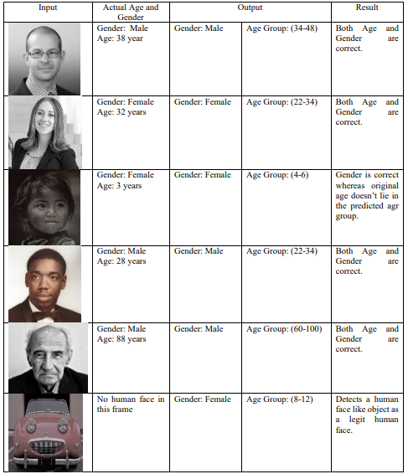
TESTING
DESIGN OF TEST CASES AND SCENARIOS:
Design and Testcases

Slide 25
TESTING
DESIGN OF TEST CASES AND SCENARIOS:
Design and Testcases

Slide 26
TESTING
ACCURACY :
Adience dataset have reported accuracy rates for age prediction ranging from around 50% to over 90%
Accuracy rates for gender prediction ranging from around 85% to over 95%
VALIDATION :
We experimented with two methods of using the network to produce age and gender predictions for novel faces:
Center Crop: Feeding the network with the face image, cropped to 227 × 227 around the face center.
Over-sampling: We extract five 227 × 227-pixel crop regions, four from the corners of the 256 × 256 face image, and an additional crop region from the center of the face.

Slide 27
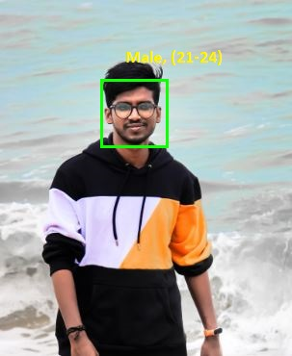
RESULTS
OUTPUT SCREENS:

Slide 28
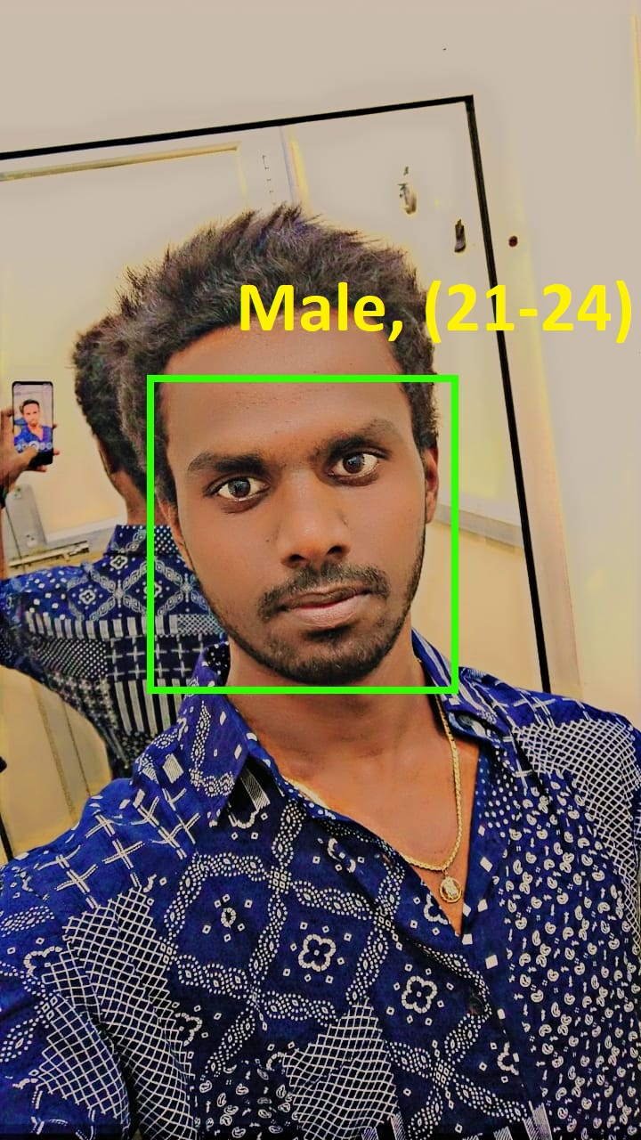
RESULTS
OUTPUT SCREENS:

Slide 29
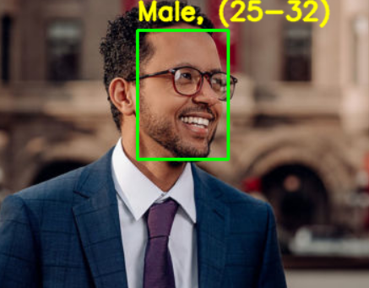
RESULTS
OUTPUT SCREENS:

Slide 30
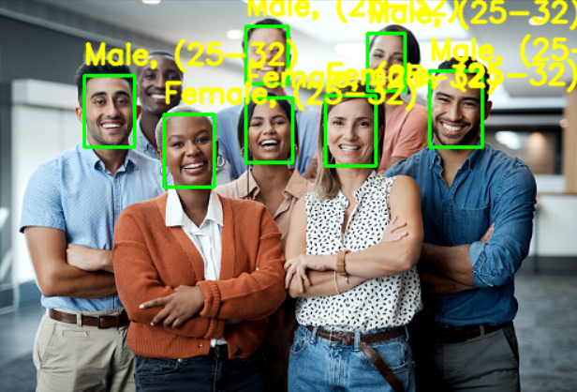
RESULTS
OUTPUT SCREENS:

Slide 31
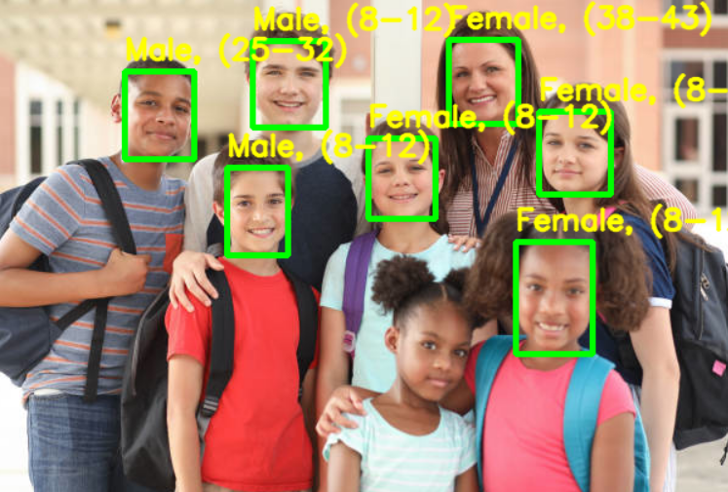
RESULTS
OUTPUT SCREENS:

Slide 32
CONCLUSION
We investigated two problems of the face processing field, face recognition, and age and gender classification. We reviewed recent developments in these two fields and our survey demonstrated that many of the existing methods suffer from difficulties in analysing data collected from uncontrolled environments. These difficulties stem from the fact that, in face, gender and age recognition problems, proposing a model that allows for an accurate recognition that can be generalized to apply to everyone is not an easy task.

Slide 33
Any Questions?

Slide 34
Thank You

